Slide 1
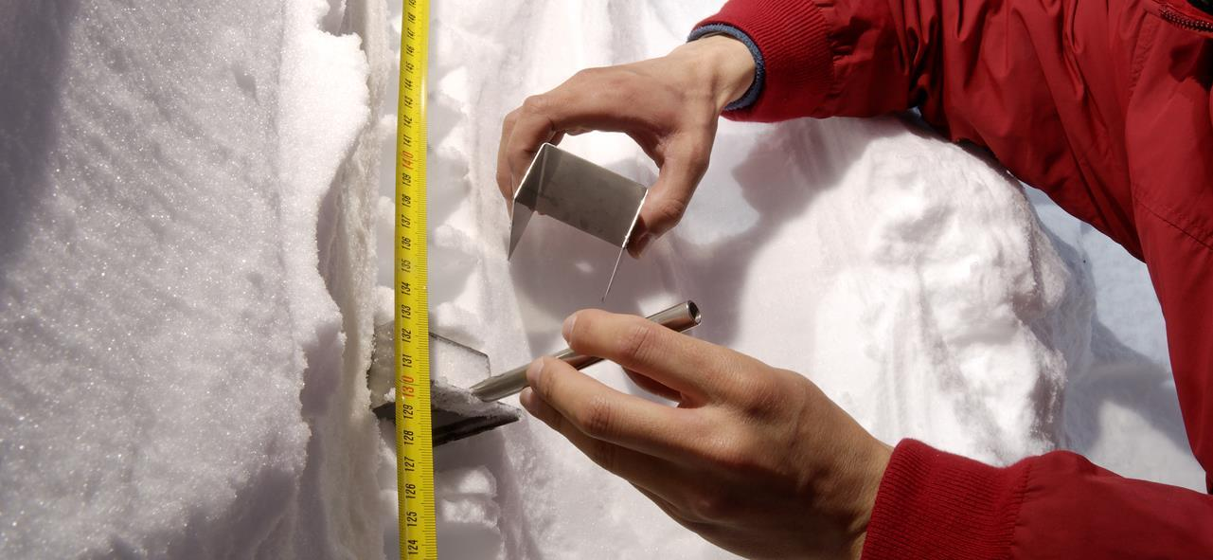

Portrait of the SNSF
Ayșim Yılmaz, Head of Division Biology & Medicine

Slide 2
Contents
The institution
Use of funds
Project Funding
Career Funding
Swiss research landscape

Slide 3
The SNSF
supports competitive basic science in all academic disciplines
was founded in 1952, under private law
is mandated by the federal government
core task: the evaluation of research proposals
Notes:
Private law > Independence of research from politics. Created by researchers for researchers.
Encouraging young talents to pursue a career in research is the uppermost priority of the SNSF.

Slide 4
The SNSF
promotes scientific basic research invests in young scientists
enables research stays abroad
promotes international co-operation
promotes gender equality

Slide 5
Strategic goals
To consolidate Switzerland’s pole position in research
To guarantee and improve the attractiveness of Switzerland for researchers
To offer research funding in line with actual needs in the different research categories
To facilitate international co-operation and support competitiveness
To embed research in society
Notes:
Multi-year Programme 2012-2016
More details, Multi-year Programme > Intranet > Über uns > Projekte > Laufende Projekte > Mehrjahresprogramm

Slide 6
Bodies of the SNSF
Foundation Council
Compliance Committee
Internal Audit
National Research Council
Divisions
I: Humanities and Social Sciences
II: Mathematics, Natural and Engineering Sciences
III: Biology and Medicine
IV: Programmes:
National Research Programmes (NRPs)
National Centres of Competence in Research (NCCRs)
Specialised Committees
Interdisciplinary Research
Careers
International Co-operation
Commissionen
Gender Equality in Research Funding
Research Integrity
Research Commissions at Swiss institutions of heigher education
Administrative Offices
Notes:
The bodies of the SNSF work at different levels towards a common goal:
scientific evaluation and financing of researchers and the projects submitted by them.
Foundation Council and Executive Committee
37 Members FC | 15 M. Executive Committee
22% Proportion of women on FC | 15% Executive Committee
1–2 Meetings per annum FC
4 meetings Executive Committee
National Research Council
97 Members
22% Proportion of women
10–12 Meetings per annum
12 Research Commissions
182 Members
21% Proportion of women
43 Meetings per annum

Slide 7
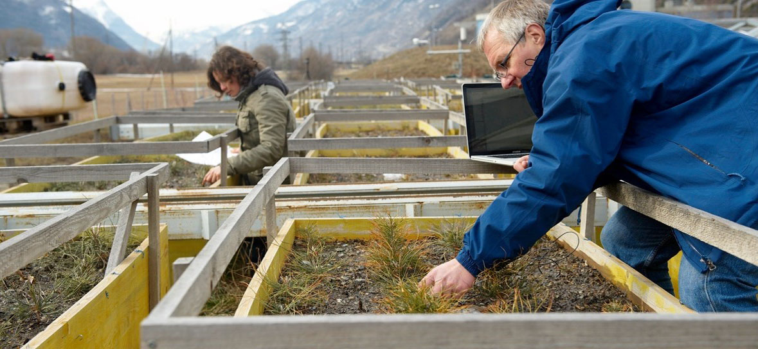
Use of funds
Notes:
In 2013, the Swiss National Science Foundation (SNSF) granted funding to the total value of CHF 818.8 million, 8.4% more than in 2012 (CHF 755.2 million).
This financing was used to support over 3,400 research projects.

Slide 8
Main financial research flows in Switzerland
Confederation
Cantons
Funding institutions
SNSF
CTI
EU
Research institutions
Federal Institutes of Technology and related reöainstitutions
Cantonal universities
Universities of applied sciences
Competitive funding
Basic funding

Slide 9
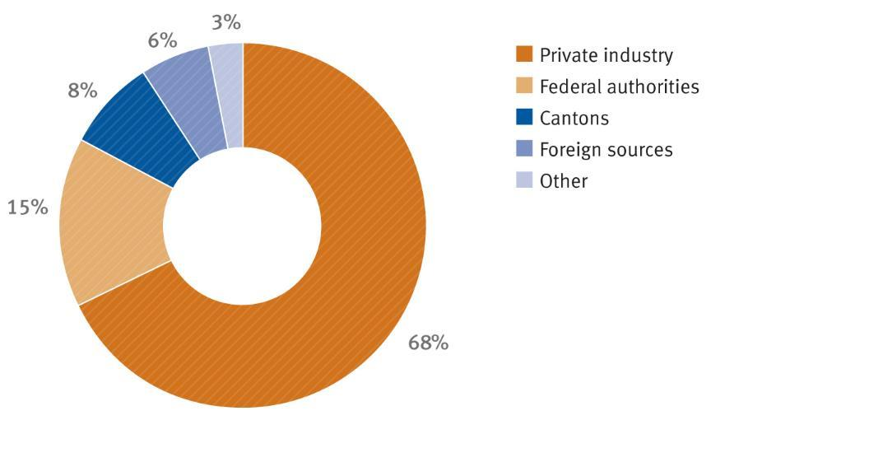
Funding: in CH
Total:
CHF 16.3 billion
OFS, 2010
Notes:
The largest proportion of research and development in Switzerland is funded privately. Public R&D funding (federal and cantonal) is at 23 % and lies below the European average.
Source: Swiss Federal Office of Statistics, OECD, as at 2008
Including flows of funds abroad

Slide 10
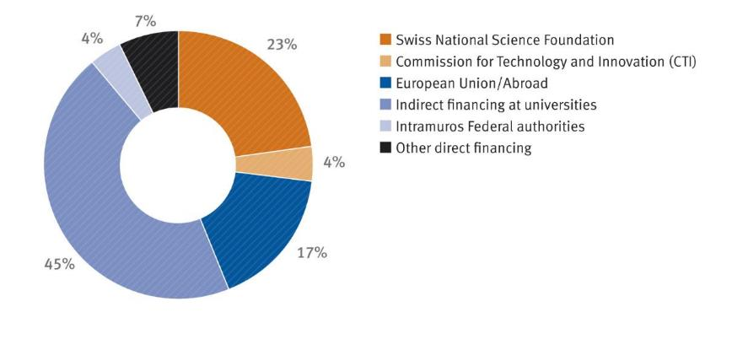
Funding: in CH: Federal
Total:
CHF 3.3 billion
OFS, 2010
Notes:
Approximately a quarter of federal funding for R&D is distributed by the SNSF. The SNSF thereby supports research at higher education institutes and research institutions based on a competitive evaluation procedure.
Source: Swiss Federal Office of Statistics, 2010
Including flows of funds abroad

Slide 11
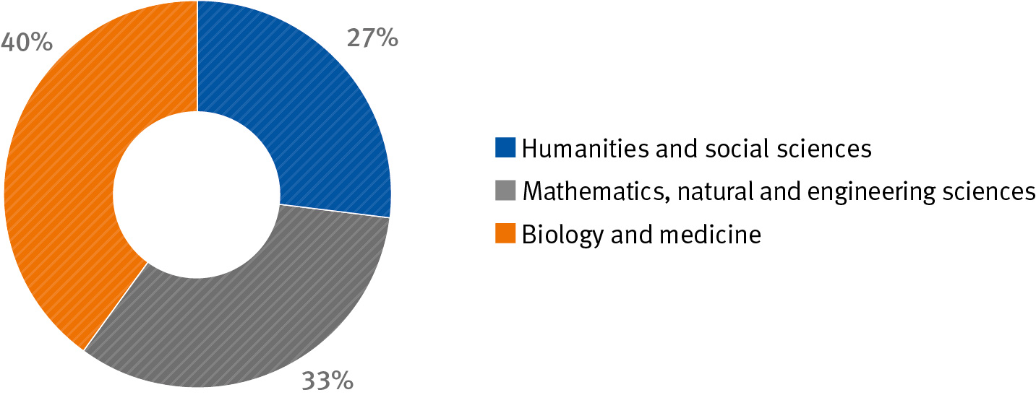
Funding (general) by research area 2013
Total: CHF 818.8 million
Notes:
(Distribution of the approved amounts)
The allocation to the research areas has changed slightly year-on-year. The share of the humanities and social sciences has risen by three percent compared to 2012.

Slide 12
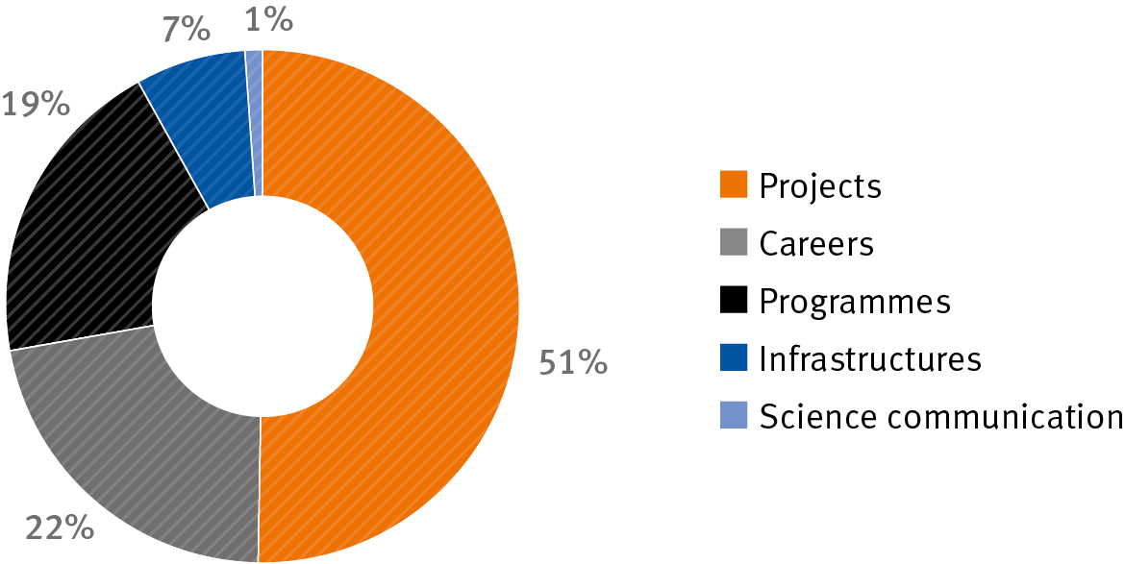
Funding (general) by scheme 2013
Total: CHF 818.8 million
Notes:
(Distribution of the approved amounts)
In 2013, the SNSF allocated more than half of its funds to its main funding scheme, project funding. The share of infrastructures has more than doubled year-on-year, from three to seven percent.

Slide 13
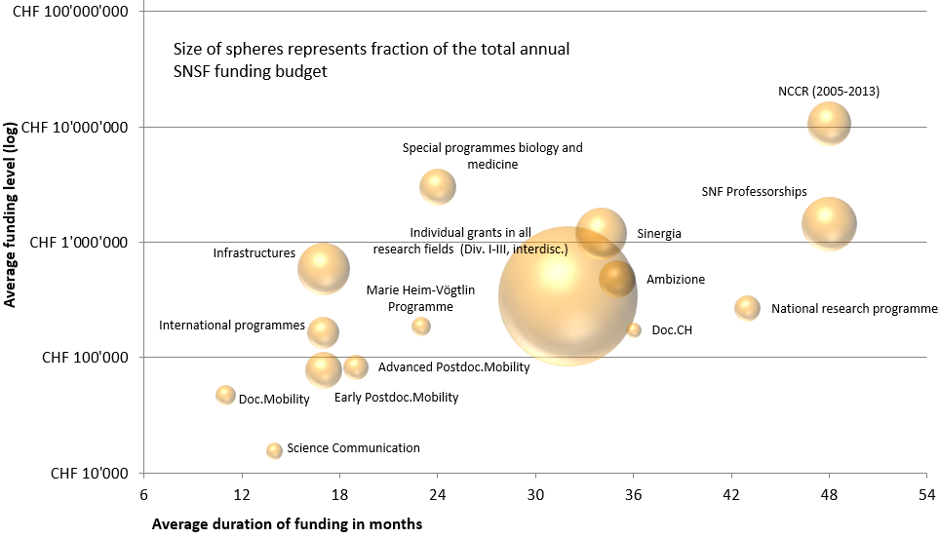
Funding by schemes 2013
How much money and time was on average assigned in the different
funding instruments of the SNSF?

Slide 14
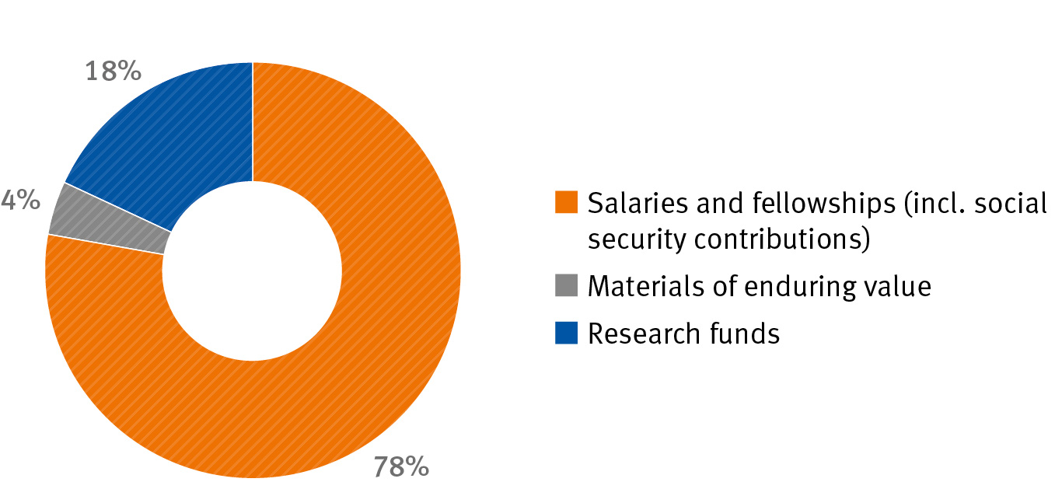
Use of approved amounts 2013
Total: CHF 818.8 million
Notes:
As in previous years, the approved funds were used by the researchers mainly to cover personnel costs, whether for the financing of individual salaries/fellowships in the context of career funding or for the appointment of personnel in research projects.

Slide 15
In summary….
Funded over 3400 projects in 2013
1700 grants for projects and programs
1400 career grants
400 grants for science communication
Funded over 8900 collaborators in research projects
in 2013
7900 via grants for projects and programs
1000 via career grants
(76% under 35 years, 46% women)
Notes:
8900 collaborators: of approximately 44,000 Swiss researchers (~22%)

Slide 16
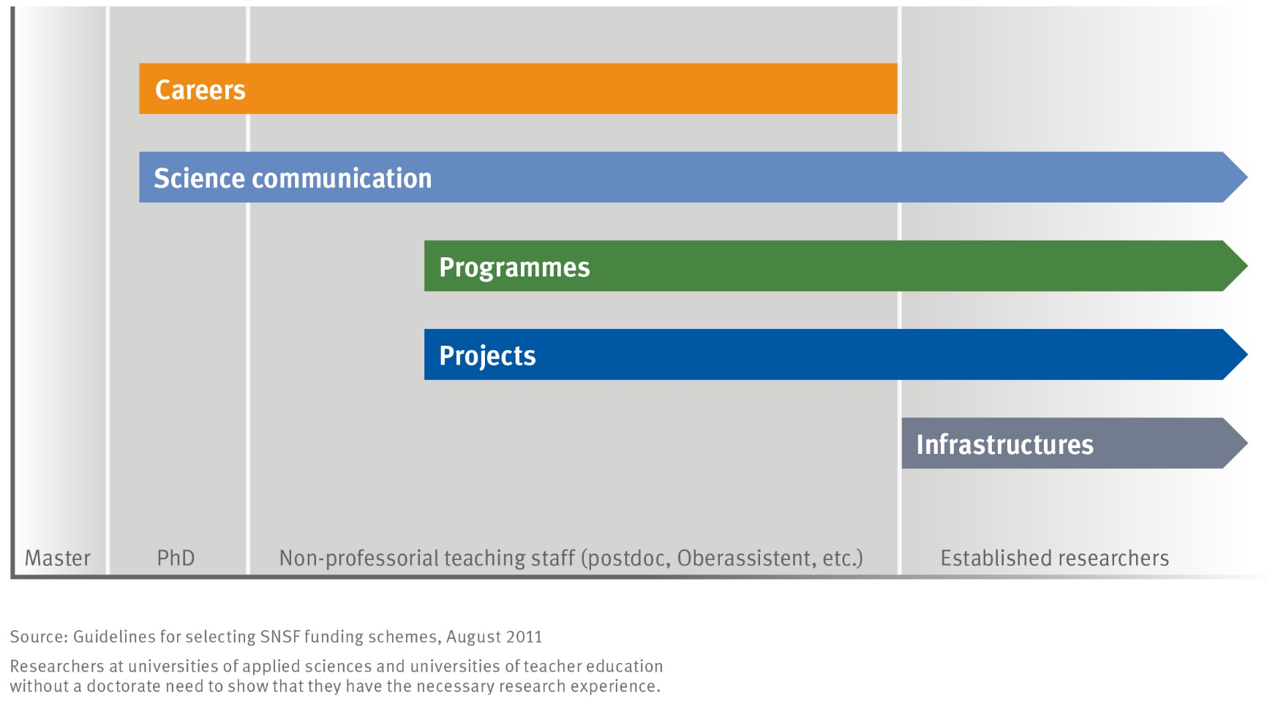
Funding opportunities: Overview
Notes:
_project funding is one main funding line in the SNF portfolio
_you need to be in an advanced stage of your research career (late postdoc or assistant professor level) to apply for a project grant

Slide 17
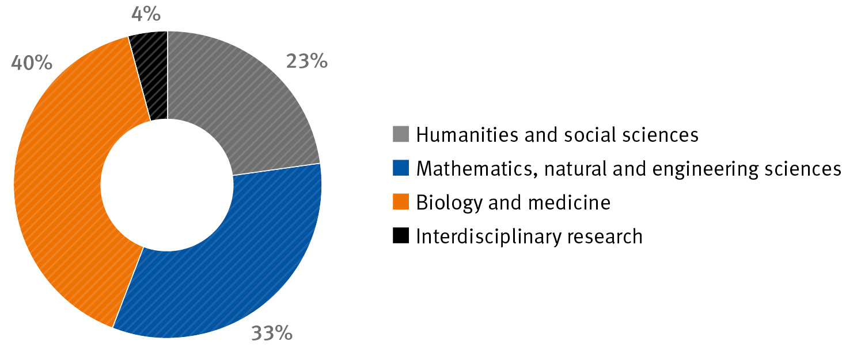
Projects – Funding by research area 2013
Total: CHF 416.5 million
Notes:
Distribution of the approved amounts.
Due to rising demand, the SNSF has made more money available for the humanities and social sciences. Their share has grown by three percent to 23% in the last two years.

Slide 18
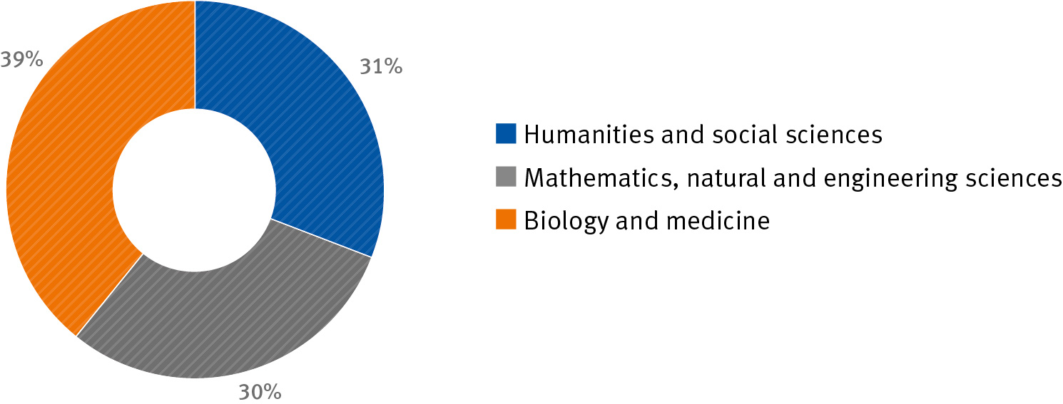
Careers – Funding by research area 2013
Total: CHF 179.2 million
Notes:
Distribution of the approved amounts.

Slide 19
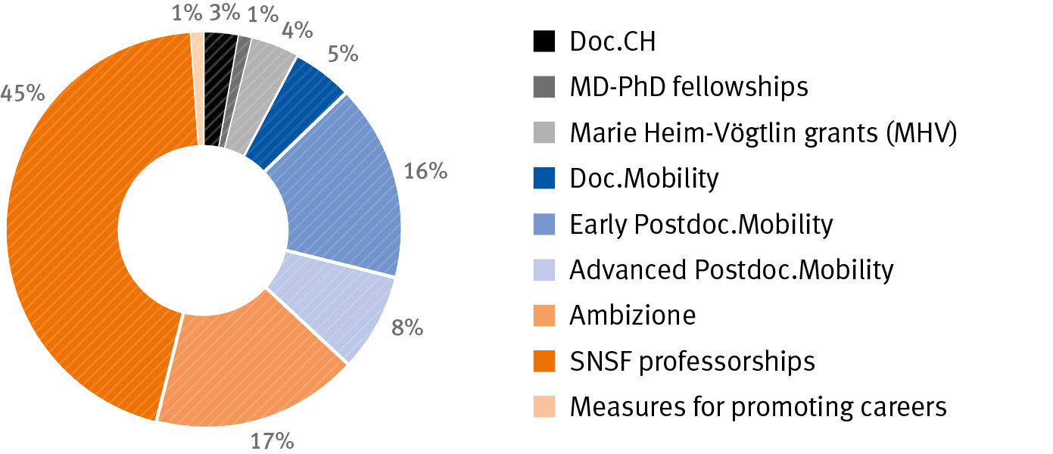
Careers – Funding by scheme 2013
Total: CHF 179.2 million
Notes:
All in all, the demand for career funding continued to rise strongly in 2013. The mobility fellowships were reorganised and the first Doc.CH grants were awarded. Postdoctoral researchers were able to apply for the new “120% support grants” as of summer 2013.

Slide 20
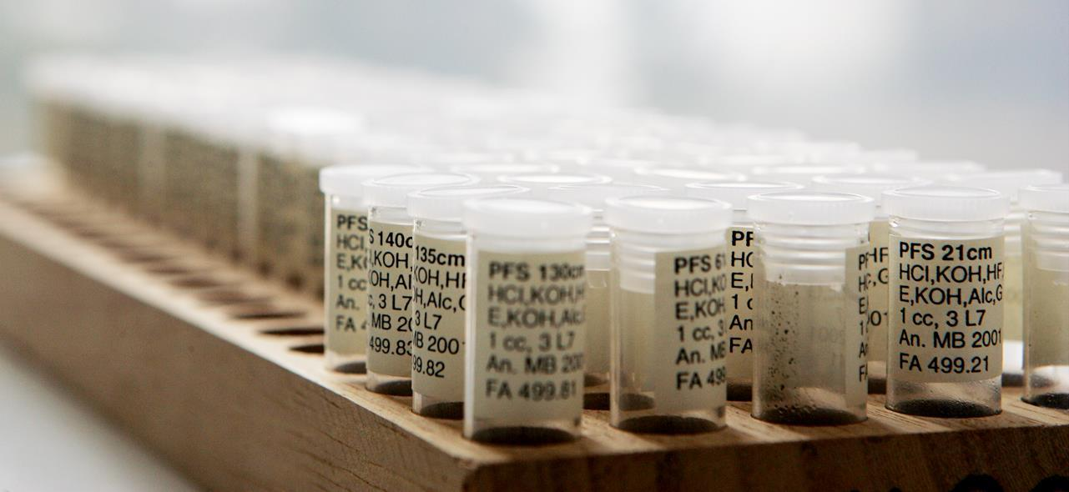
Project Funding in Biology & Medicine

Slide 21
Project funding
Grants (< 340’000/y) for research projects that do not pursue immediate commercial goals
Open to all research topics and disciplines
Individuals or research groups acting as applicants
Project duration: up to 3 years
Use of grant for personnel, research costs and small equipment, salary of applicant(s) excluded
Notes:
_no immediate commercial application: does not exclude patentability of findings, IP with institution and researcher, not with SNF
_research costs include e.g. disposables, chemicals, or scanner time for px
_small equipment << 100’000, more expensive equipment to be applied for via R’EQUIP
_salary: you may also not be paid by a different SNF grant

Slide 22
Project funding
Free choice of research themes
All scientific disciplines
Calls: 1st April / 1st October (excl. spec. programmes)
Project evaluation (peer review):
Selection of projects in competition
Decision about six months after submission

Slide 23
Evaluation criteria
Proposed project
Scientific (clinical) relevance, topicality and originality
Suitability of methods and feasibility (within grant period)
Applicants
Scientific track record
(documented) Professional expertise with regard to the project

Slide 24
Who is eligible for project funding?
Project funding is for researchers who…
can show that they have successfully worked as researchers (post doc) for several years
are capable to conduct their own research project independently (group leaders)
make a substantial (at least 30%) personal contribution to the project
have access to the necessary infrastructure
(see “SNSF funding regulations”, article 8/13)
Notes:
_post doc: “mehrjährig” > 2 years
_are autonomous in the realisation of their research

Slide 25
Evaluation steps
Formal check (eligibility, manifestly insufficient)
International peer review
Competitive evaluation and selection by the National Research Council
Notes:
_formal evaluation:
_earlist starting date: grants must be opened within a 12 mo period following the date of the decision letter

Slide 26
Writing a successful research proposal
A solid research plan is key!
Start early; read and follow the guidelines
Adhere to instructions re: structure, length, font size
Build a sound rationale, formulate few focused and testable hypotheses based on a complete literature review and your previous related work
Define expected concrete outcome after 3 years (note: the SNSF funds projects, not concepts)
Describe methods, project management, alternatives, plan B
Own preliminary results prove feasibility
A realistic budget shows that you know what you are doing
Notes:
_start early: each year grants are declined because they arrive minutes too late
_guidelines: research plans that do not adhere to SNSF format are rejected
_hypotheses: often long lists of declarations; focus on a few statistically testable hypotheses
_reviewers: complete (!) literature review, reviewers want to see their work cited; update review before re-submitting
_concrete outcome: no fishing expeditions, no try and see _Methods description: detailed enough (i.e. shorten general blabla in introduction) to judge feasibility, provide methods paper if necessary, contingency planning
_budget: you do not increase your chances by asking for less than you need; the NCR will probably shorten anyway

Slide 27
If you are applying for your first grant
Develop and follow your own independent line of research, demonstrate your scientific independence and your ability to lead a project
Show mobility, follow your line of research at different places
Do not apply to do your mentor’s/superior’s research
Having your mentor/superior as a co-applicant on the grant may make it more difficult to prove your scientific independence (if so, explain!)
Get an independent research group leader position
«support letters» from mentors/superiors can be contraproductive; they should only confirm your access to infrastructure
Show experience and competence
Demonstrate your professional experience and competence in this area of research with 2-3 years of postdoc,
Have publications as first and (corresponding) last author

Slide 28
Development of applications and grants
Notes:
_if you have done it right, your project will be funded
_funding rates vary very much with experience of the applicant; young applicants may rather face a 20% success rate, these increases with re-submission

Slide 29


Clinical Research Projects
Evaluated over 2800 projects from 2010-2013 (4y)
Funded 1372 projects (47.6%) in total,
Funded 280 projects in the medical and clinical field

Slide 30
If you are not successful…
Read the rejection letter carefully, it explains the reasoning of the National Research Council
External reviews may contain more information; but cross-check with letter
Contact the SNSF office for clarification and advice
Try again with an improved application
Comment on the changes made and provide a point-by-point response to critical points raised by NRC and by reviewers
Reconsideration request or appeal (within 30 days!)
Notes:
_rejection letter: explains reasoning of the NRC and shows possiblities to improve your project; letter indicates the funding priority (1. outstanding, 2. excellent, 3. very good, 4. good, 5. average, 6.poor)
_externa reviews: can be consistent or not with the decision of the NRC, very often too positiv, or too negative; NRC puts these reviews into context and does a comparative rating with all applications of the semester;
_improved application: chances go up; you have to wait a year; improve your grant, more preliminary data, include new findings
_reconsideration/appeal: request reconsideration if procedural mistake or important misunderstanding; needs be done fast, since appeal to the Bundesverwaltungsgericht only possible within 30 d from date of decision letter;

Slide 31
Scientific misconduct
As last step of the submission process of an application on mySNF, all applicants confirm that «... Earlier work of the applicants and third parties is declared as such and publications of the applicant(s) and of third parties are correctly cited.”
The SNSF has a software that compares the text of proposals with billions of web pages & millions of research articles
A significant part of the applications of any call or submission date are checked at random. Also, any hint or observation by external reviewers, members of the research council or the scientific management is examined.
Notes:
_before submitting an application in mySNF you have to accept a statement on proper citation of sources
_possible consequence of scientific misconduct: exclusion from submission for extended periods of time; the SNSF reports yearly on number of projects screened, cases found and sanctions made
_Important also when working with Co-authors

Slide 32
If you are successful in obtaining funds You can further ask for….
Mobility grant in project
Promotion of mobility for PhD student employed in research projects funded by the SNSF
Duration: 6 – 12 months
Up to CHF 20’000 (travel and living costs, fees for conferences and workshops)
120% support grant
Aimed at postdoctoral researchers employed in SNSF-funded research projects with at least 80% work time, to achieve a better balance between career and family
Grantees are excluded form the measure (as of July 2014 exception for Ambizione grantees)
Limited budget: “First-come – first served”

Slide 33
Don’t overlook other SNSF instruments
Sinergia –large consortium projects with 3-4 subprojects; one group may be based abroad; submission 1x/year (January 15)
R’Equip – To purchase costly equipment (50% covered by institution)
Interdisciplinary projects – project including 2 or more scientific disciplines, all disciplines must profit
Conference grants
Et cetera: http://www.snf.ch
Notes:
_However: all aimed at experienced researchers…

Slide 34
Special initiatives for biology and medicine
Longitudinal studies
Investigator Initiated Clinical Studies (1st call in 2015)
Biobanking data-linking funds (1st call in 2015)
SPUM - Special Programme University Medicine (ending)
Swiss Biobanking Platform (SBP)
Swiss Clinical Trial Organisation and CTU Network
Notes:
In the context of its patient-oriented clinical research funding schemes, the Swiss National Science Foundation (SNSF) has been funding the following 8 multicentric cohort studies since 2006:
The Swiss Venous Thromboembolism Cohort 65+ (SWITCO-65+, D. Aujesky)
Swiss HIV Cohort Study (SHCS, P.B. Francioli)
Cohort study on Substance Use Risk Factors (C-SURF, G. Gmel)
The Swiss National Cohort (F. Gutzwiller)
Cardiovascular diseases and psychiatric disorders (M. Preisig)
Swiss Cohort Study on Air Pollution and Lung and Heart Diseases in Adults (SAPALDIA, T. Rochat)
Swiss Inflammatory Bowel Disease Cohort Study (SIBDCS, G. Rogler)
Swiss Transplant Cohort Study (J.U. Steiger)
The SNF has launched a new call for the support of longitudinal studies. Submission deadline for pre-proposals is March 4, 2013.
Special programme university medicine - Building clinical research capacities for the future
As part of its clinical research funding schemes, the Swiss National Science Foundation (SNSF) finances 10 projects designed to promote young clinical researchers in Switzerland by funding multicentric, multidisciplinary clinical projects with a translational character in the areas of cardiovascular diseases and neurosciences. No new call is planned.
Platforms for the promotion of translational and clinical research
Grants for multi-centric, population-based and disease-oriented studies with a longitudinal design (longitudinal studies) are aimed at researchers in Switzerland. A one-off call for proposals was issued on 4 March 2013.
The SNSF contribution complements funding of the responsible institution and depends on the size of the study. As a rule, it may not exceed CHF 2 million per year.

Slide 35
Funding opportunities within Europe
SNSF participates in ERA-Nets, JPIs
Lead agency agreements with DFG, FWF, ANR, Luxembourg
Money Follows Researcher: to facilitate moving within Europe
Money Follows Cooperation Line: to facilitate international collaborations
Notes:
Money follows researcher
The project can either continue in Switzerland while being managed from abroad or transferred to a new location.
Agreements are in place with most European countries.
Inquire about non-European countries
Money follows cooperation line: SNSF may allow you to use a small amount of your grant to pay for costs incurred at a foreign collaborating institution (e.g. paying for recruitment or analysis costs), has to be asked for at submission

Slide 36
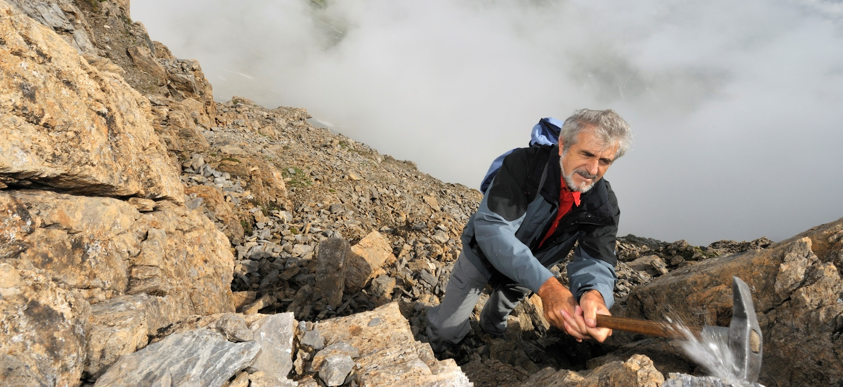
Some other initiatives
Notes:
Caption: Adrian Pfiffner, Geologist,
Photographer: Andri Pol, 2008

Slide 37




Sinergia
Small inter-institutional
networks (Collaborative projects involving 3-4 research groups)
Interdisciplinary or disciplinary and innovative projects
Competitive scheme for experienced researchers
Notes:
Collaborative project involving 3-4 research groups
Possibility of participation by a foreign research group
Disciplinary or interdisciplinary
Duration: max. 36 months, 1 follow-up project possible
Around 90 proposals each year
Budget CHF 56 million (2013)
"The whole is more than the sum of its parts" (Aristotle) - true to this motto, the Swiss National Science Foundation (SNSF) supports small networks where a synergetic approach is needed to venture into promising new research fields, tackle complex research questions and gain pioneering insights.
Objective: to break into promising new areas of research and strengthen outstanding research in Switzerland

Slide 38
R’Equip
To purchase or develop research equipment
Useful to multiple researchers and projects Considers overall Swiss context
Beyond standard infrastructure
Grants between 50 kfr. and 1 Mfr.

Slide 39
Interdisciplinary projects
Reciprocal reference between two or more disciplines
Reference to common theoretical concepts and methods
Duration: max. 36 months, 1 follow-up project possible
Annually approx. 80-100 applications
Budget CHF 13.3 million (2013)

Slide 40

Career funding
Notes:
Picture: “Thanks to the support from the SNSF, I was able to combine research work with family life.”
Marketing researcher Lucia Malär, job-sharing assistant professor, received the Marie Heim-Vögtlin Prize 2013 in recognition of her research work and her career development.
Photographer: Severin Nowacki
© SNSF

Slide 41
Career funding
Open to all research topics and disciplines (exceptions: Doc.CH and specific schemes for energy research)
Only individuals can act as applicants
Allows to conduct a research project at an institution of higher education in CH or abroad
Project duration: depends on the scheme
Use of grant: living costs of applicant, research funds (depending on the scheme: consumables, small equipment, congress costs, personnel, child care…)

Slide 42
Which are the main target groups? (Eligibility)
Career funding addresses young researchers who…
are in the qualification stage (between PhD and assistant professorship)
have a promising track record, relative to their research experience
are aiming at a scientific or academic career
apply for their own living costs and, depending on the scheme, additional project costs
have the support of a research host institution during the grant

Slide 43
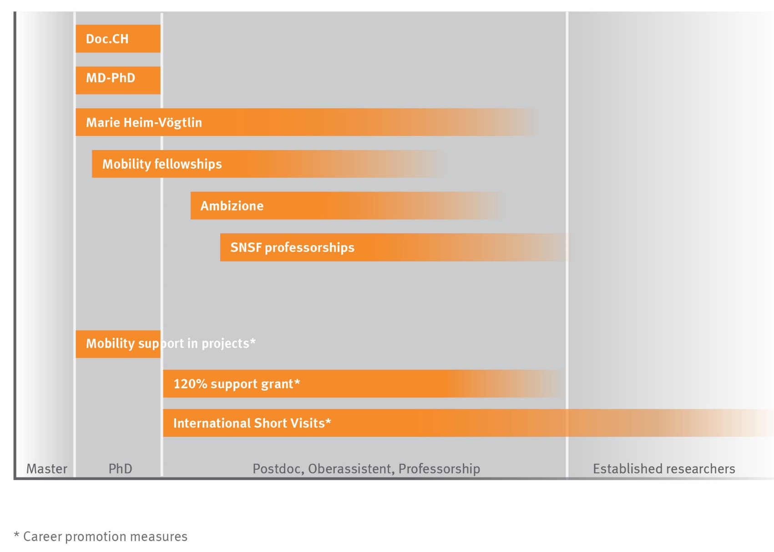
Careers

Slide 44
Writing a successful research proposal
In your research project
show your own contribution to the project
if applying for a mobility fellowship, describe the gain of the stay abroad
if requesting personnel (depending on the scheme: PhD students, postdocs, etc.), detail what part of the project they would do
Notes:
In addition to what was said before, that applies to Career schemes too, as a young researcher it is important to:

Slide 45
Writing a successful research proposal
In your Curriculum vitae
indicate dates with month and year
PhD: give the date of the defence
For clinical researchers: give the date of your medical licence and of your MD
mention your research experience in academia and industry
List interruptions, reduced level of employment in your scientific career (maternity, dual career couple, employment outside of academia, prolonged illness…)
Notes:
Your CV must show your scientific achievements but also allow to verify if you fulfill the formal requirements of the scheme. A well structured and not overloaded CV is a good start.

Slide 46
Writing a successful research proposal
In your publication list
separate publications resulting from PhD/MD (or prior) and from your postdoc period in two sections
add a comment on your contribution in publications with several authors where you are not first or last author, or for disciplines where authors appear in alphabetical order
Separate publications in peer‐reviewed journals (original work vs. review articles), conference proceedings, monographs, patents
Notes:
Here again, refer to the indication in the guidelines of the scheme. It is a good idea to:

Slide 47
Writing a successful research proposal
Your host institution is expected to
welcome you for the duration of the grant in a confirmation letter (integration, support, infrastructure, independence, complementarity with your research, etc.)
offer you the best environment for your project and your career
allow you to develop your scientific independence
allow you to gain mobility (depending on the scheme)

Slide 48
Marie Heim-Vögtlin
For female doctoral students and postdocs
at Swiss higher education institutions who
were forced to reduce or interrupt research activities due to their family situation.
Duration: until 2 years (max. 1 year extension)
Part-time employment possible (at least 50%)
Notes:
Promotion of women
All disciplines supported by the SNSF
Approx. 35 subsidies per year

Slide 49
Doc.Mobility
Fellowship for doctoral students to go abroad lasting between 6 and 18 months
Matriculation as a doctoral student for at least 12 months
At least 1 year working at a research institution in Switzerland (for foreign persons)
Submission deadlines: 1 March and 1 September

Slide 50
Early Postdoc.Mobility
Fellowships lasting 18 months for postdocs starting their careers and wanting to go abroad
Submission up to 9 months before and up to 2 years after the doctoral exam
For medical researchers: submission up to 6 years after the state examination
At least 3 years working at a research institution in Switzerland (for foreign persons)
Submission deadlines: 1 March and 1 September

Slide 51
Advanced Postdoc.Mobility
Fellowships for advanced postdocs abroad lasting between 12 and 36 months with a return option to Switzerland for a duration of 3 to 12 months
Doctorate and research experience of at least 1 year at postdoctoral level
At least 3 years of research activity in Switzerland (for foreign applicants)
Submission up to 5 years (benchmark) after the doctoral exam (for medical researchers: no later than 9 years and at least 3 years of clinical activity after state examination)
Submission deadlines: 1 February and 1 August
Notes:
Approx. 100 fellowships per year

Slide 52
Ambizione, Ambizione-PROSPER/SCORE
Research in Switzerland: returning or incoming
Generally up to 5 years’ research experience after PhD
For medical practitioners: at least 3 years of clinical activity since graduation. Application must generally be submitted up to 9 years after obtaining medical licence (state examination).
Research stay of at least 12 months in an institution other than where the candidate obtained the doctorate
The host institution grants appropriate support to the research costs
Own salary, project funding, personnel, possibly doctoral candidate
Duration: 3 years (generally no extension)
Notes:
Approx. 50 subsidies per year

Slide 53
SNSF Professorships
Enables researchers to establish their own teams for the realisation of a research project
Academic age: 2–9 years research experience after PhD
Allowance max. CHF 1.6 million:
Own salary
Research allowance for team (2-3 researchers)
Possible infrastructure allowance
Duration: 4 years (max. 2 years extension)
Notes:
Approx. 40 subsidies per year

Slide 54
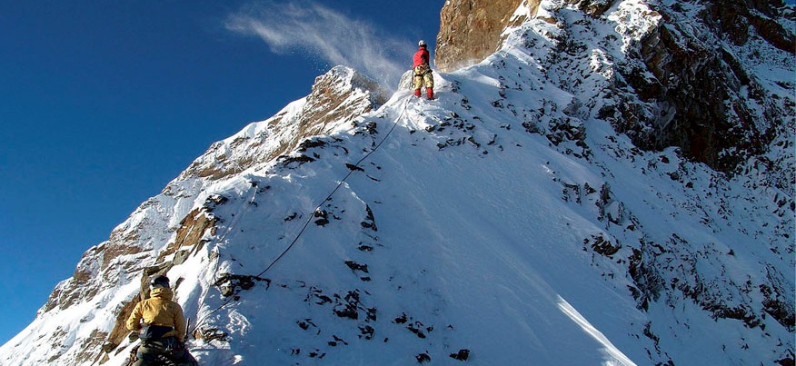
Swiss research landscape
Notes:
Caption: Once a year, researchers download the data of the sensors which are installed on more than 30 rock faces to verify the results of their models. They also have to check the functionality of the measuring equipment, as they are doing here on the eastern ridge of the Jungfrau.
Photographer: Stephan Gruber

Slide 55
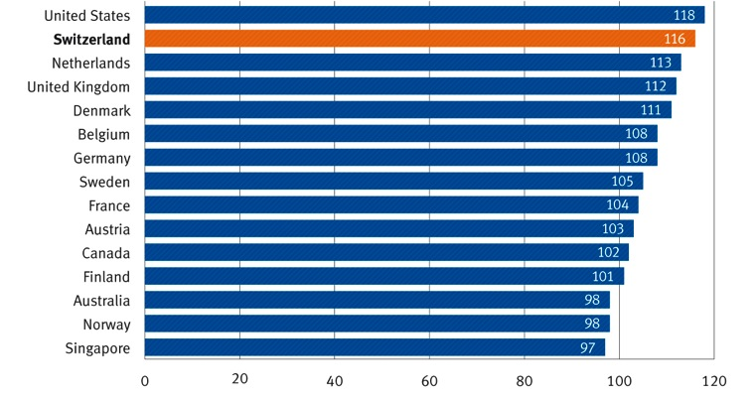
Impact of scientific publications
Relative citation index
Source: Thomson Reuters (SCI/SSCI/A&HCI), adaption SERI 2011
Notes:
(The graphs will be replaced at the end of June when updated figures will be available.)
The relative citation index provides a measure for the impact of publications. Switzerland lies 16 percentage points above the global average and holds second place.
15 coutries with the best percentage.

Slide 56
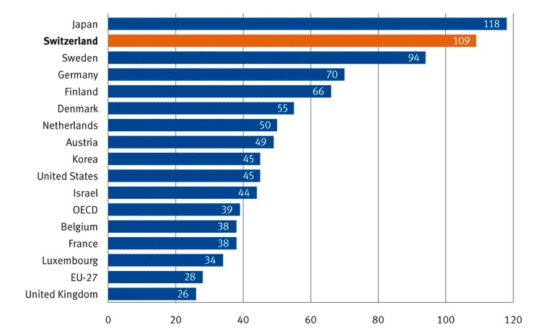
Patents
Number per million inhabitants
Source: OECD, as of 2009
Notes:
(The graphs will be replaced at the end of June when updated figures will be available.)
* Patents that have been registreded simultaneously with European and Japanese patent offices as well as granted by the US Patent & Trademark Office (triadic patent families)

Slide 57
Success rates at the ERC by country
EU member states
Associated countries

Slide 58
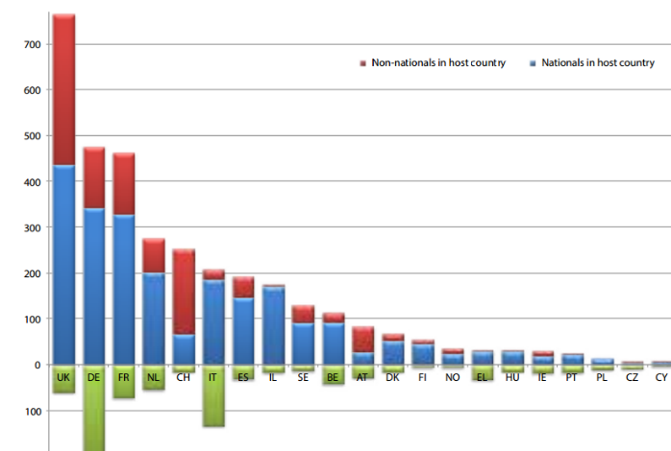
ERC grantees in Host country and abroad
non-nationals in host country
nationals in host country
nationals in foreign country
ERC Annual Report 2013

Slide 59
Switzerland - Key facts (I)
A small country
Population: 8 million
Area: 42,000 km²
Few natural resources
An open country
Official languages: German, French, Italian, Rhaeto-Romance
22.3 % of Swiss inhabitants of foreign origin
1 franc out of 2 in the GDP from exports
Notes:
Source:
_ 22,3 % of Swiss inhabitants of foreign origin (BFS, Die Bevölkerung der Schweiz 2012, p. 2)

Slide 60
Switzerland - Key facts (II)
International higher education & research
30% of students are from abroad
50% of PhD candidates are from abroad
48% of professors are from abroad
Notes:
Source:
_ 30 % of students from abroad (Studierende = alle Studienstufen, inkl. Doktorierende) (BFS: Studierende nach Hochschule und Studienstufe, 2012/2013)
_50 % of PhD candidates from abroad (BFS: Studierende nach Hochschule und Studienstufe, 2012/13)
_48 % of professors from abroad (BFS: Personal nach Personalkategorie, Herkunft und Hochschule – Personen, 2011)
All persons who do not have Swiss nationality, including persons with Swiss residency, are considered “persons from abroad”, in line with the official SHIS categorization.

Slide 61
International Co-operation strategy
Optimise and facilitate the conditions under which international collaboration and scientific exchange can take place
Lower barriers for cross-border co-operation on individual projects, international programmes, and access to research infrastructure
Facilitate researcher mobility, foster institutional co-operation, and build scientific capacity in research communities in developing nations and countries in transition

Slide 62
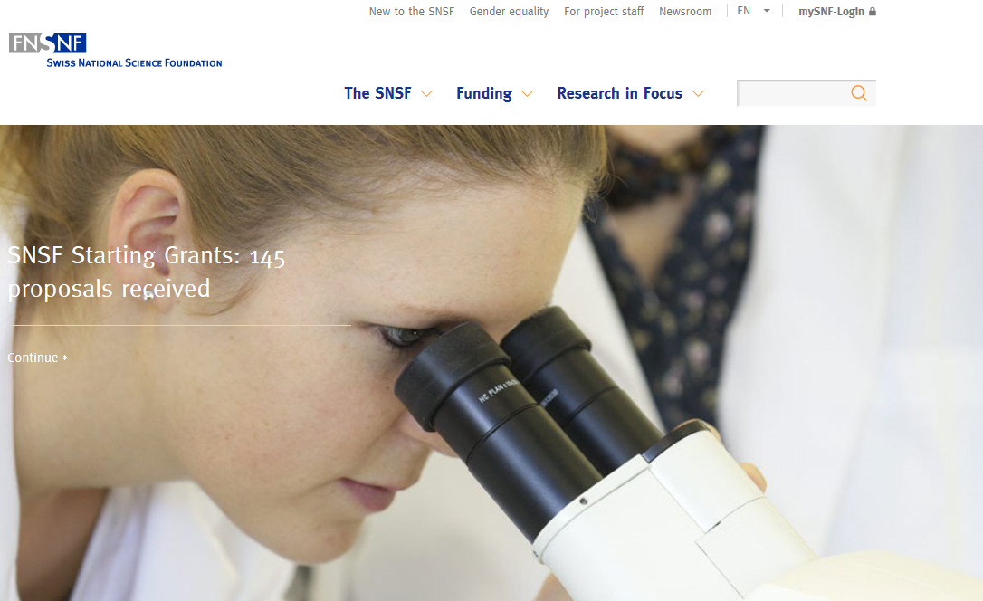
www.snsf.ch
Notes:
Aber auch…
SNF Publikationen:
Jahresbericht, Portrait und Zahlen & Fakten, Portrait des NFP und NFP, Broschüre über die Förderungsinstrumente, Horizonte, usw.
Elektronische Kommuniaktion:
Newsletter + News-Service du FNS, Newsletter des NFP
Veranstaltungen für die Forschende:
Tag der Forschung, Advanced Researchers’ Day

Slide 63



Further information
Do not hesitate to contact us!
+41 031 308 22 22
Twitter.com/snsf_ch snf_ch fns_ch
Facebook.com/snf.fns.snsf.ch
LinkedIN.com/company/snsf

Slide 64
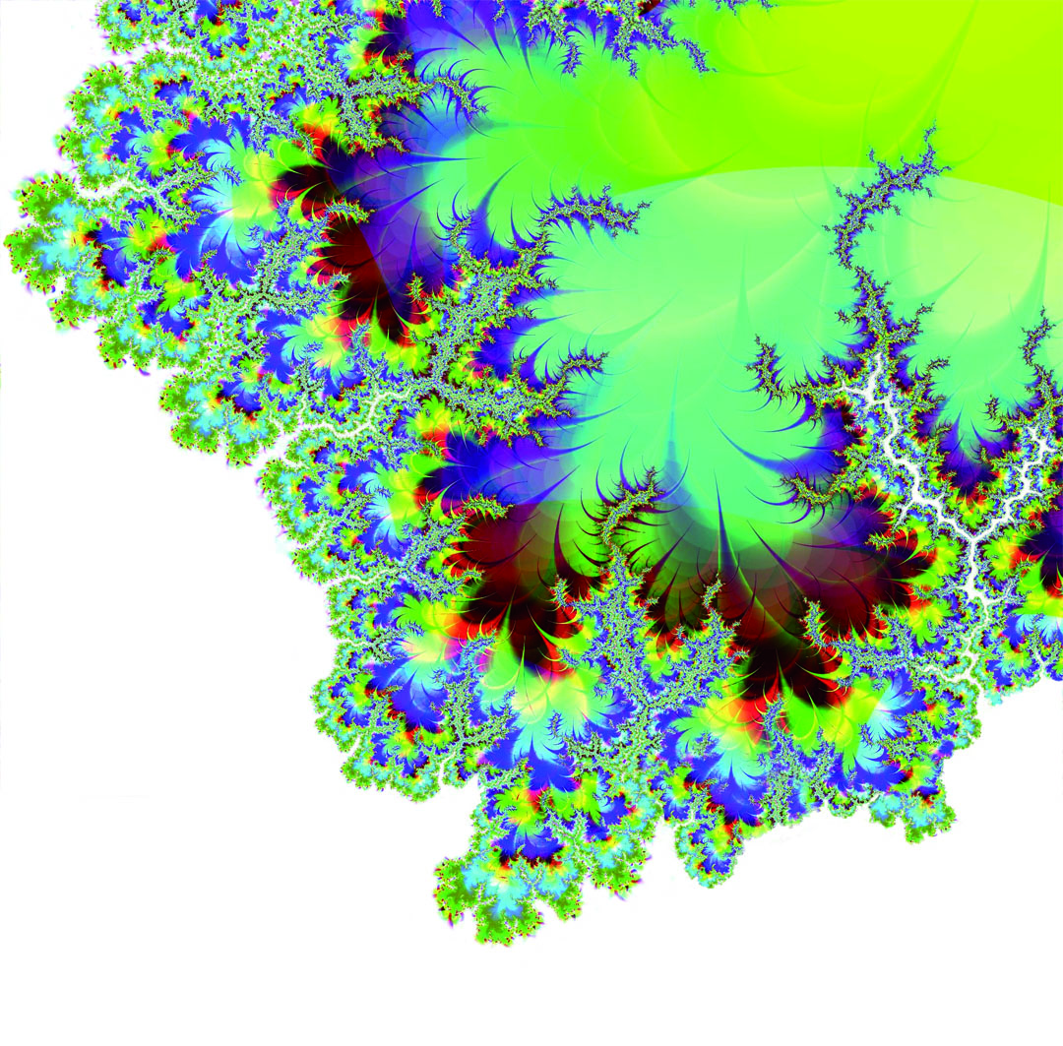
Thank you for your attention

